Slide 1
Sentiment Analysis of President’s Twitter Comments
Team member: Xiaohan Liu, Tong Shen

Slide 2
1
Approach
Agenda
2
Data
3
Experimental results
4
Data analysis

Slide 3
1
Approach

Slide 4
“
Study the tendency of public opinion on Twitter towards the two presidential candidates.
Use Twitter API to scrape candidates’ recent tweet replies.
(Anticipated dataset size 20,000. 4000 for now.）
Doing some cleaning and sentiment analysis based on replies using TextBlob.
Data visualization: Histogram，boxplot，word cloud and pie chart
Evaluate the model: Use F-score to evaluate the model.
Notes:
抓数据：We have already scrape total 4000 replies. What I will introduce next is base on those 4000 replies. But we will continue to scrape more data until the dataset is 20 thousands.
数据分析：
We have done some cleaning on the text which isn’t returning any meanings and apply our algorithm for classifying text into either positive sentiments or negative sentiments.
可视化：无

Slide 5
2
Data

Slide 6
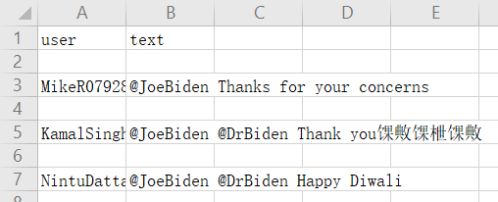
Social Media:
Twitter
Data Source:
20,000 recent tweet replies of two presidential candidates and two vice presidential candidates
Notes:
平台：
It’s obvious that twitter is one of the social media which is important in the election. As we all know Trump likes to tweet.
数据来源：
Doing sentiment analysis based on replies rather than tweets is more objective to the candidates.
The content of tweets is not only affected by public opinion but also political issues. So, the result from analyzing tweets is not so persuasive.
But if we analyze replies based on particular candidates’ tweets, we can eliminate these errors.

Slide 7


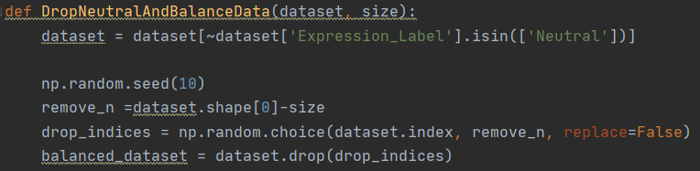
Data processing：
Get polarity and subjectivity value through sentiment analysis.
Label positive,negative or neutral if polarity > 0, < 0 and = 0
Drop all rows with neutral polarity and make our dataset balanced using a random method.
Notes:
第一步：
Polarity ranges from -1 to +1(negative to positive) and tells whether the text has negative sentiments or positive sentiments.
Subjectivity ranges from 0 to +1( negative to positive) . So, the higher subjectivity means less factual data and mostly public opinion.
第二步：无
第三步：
Even, it contains a large No. of neutral polarities that aren’t contributing to our analysis. So we drop them all.
After we balanced our dataset, we should get same number of reviews for each presidential candidates.

Slide 8
Experimental results
3

Slide 9
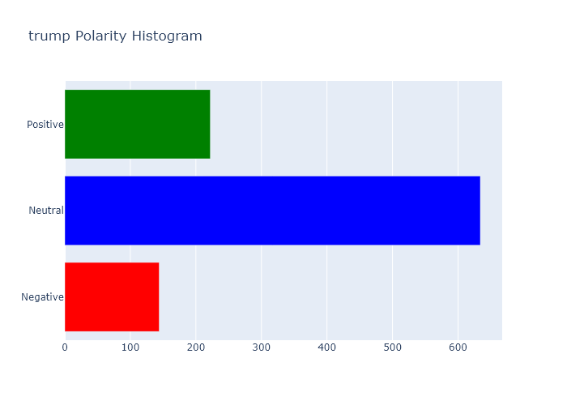
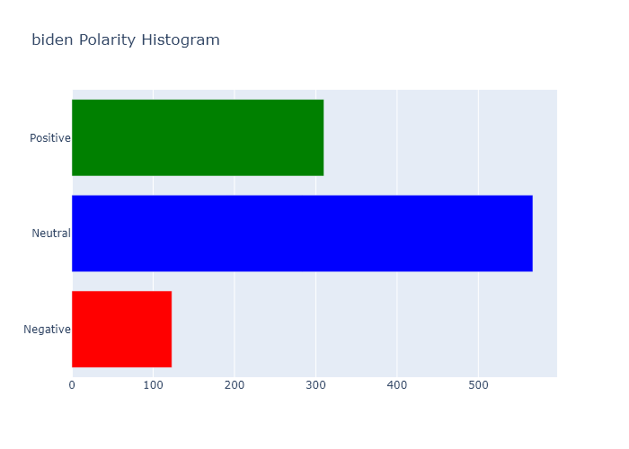
Histogram
Trump:
positive 222
negative 144
neutral 634
Biden:
positive 310
negative 123
neutral 567
Notes:
Most of the replies are neutral. But whether this part of the reply is considered, the positive percentage of Biden’s is larger than Trump’s

Slide 10
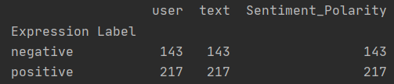
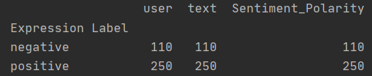
statistical results
Positive:
60.28%
Positive:
69.44%
Notes:
This is the specific number of positive and negative replies after balancing the data.
(We kept 360 replies each person with non - 0 polarity value. )
We can easily draw the conclusion that Biden have more positive replies than Trump.

Slide 11
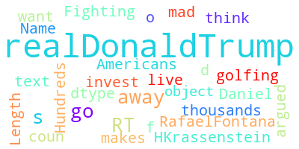
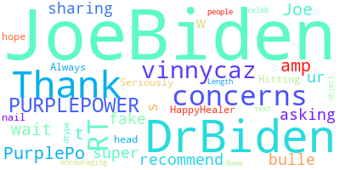
Word Cloud
Notes:
This is the word cloud we selected according to frequency from those replies.
We can see words like ‘away’, ‘golfing’, ‘mad’ in Trump’s word cloud that represent people’s dissatisfaction.
We see both ‘thank’ and ‘fake’ in Biden’s word cloud that represents the views of people from different positions.

Slide 12
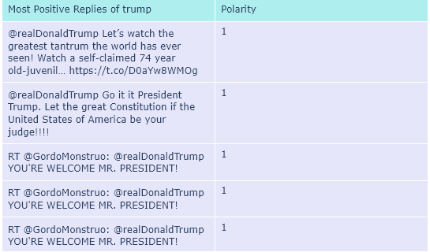
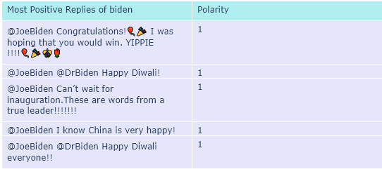
Most positive reviews
Notes:
Here are the most positive reviews in each person’s replies.
For Trump, his supporter think he is the real president although he is already lose in vote.
For Biden, lots of people congratulated him on becoming a true leader.

Slide 13
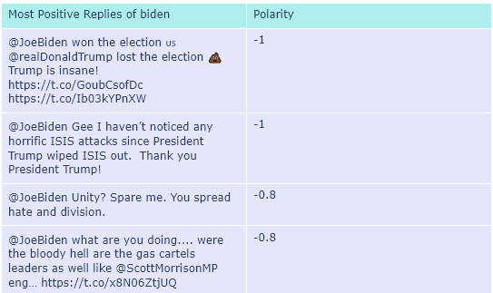
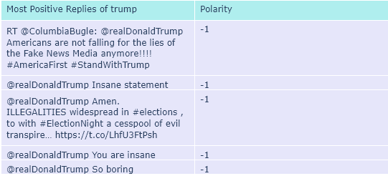
Most negative reviews
Notes:
Here are the most negative reviews in each person’s replies.
For Trump, some people think that his many actions after the election were insane.
In Biden’s replies, the first reply says some dirty words but it’s towards to Trump. So, it looks like our algorithm still need some improvements.

Slide 14
Vice President (optimal)
Notes:
Most of the replies are neutral. But whether this part of the reply is considered, the positive percentage of Harris’ is larger than Pence’s

Slide 15
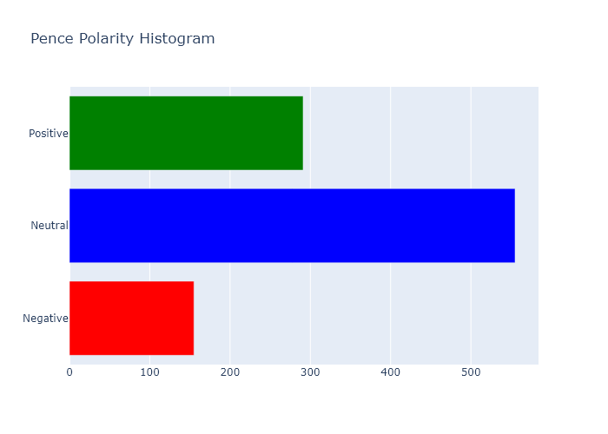
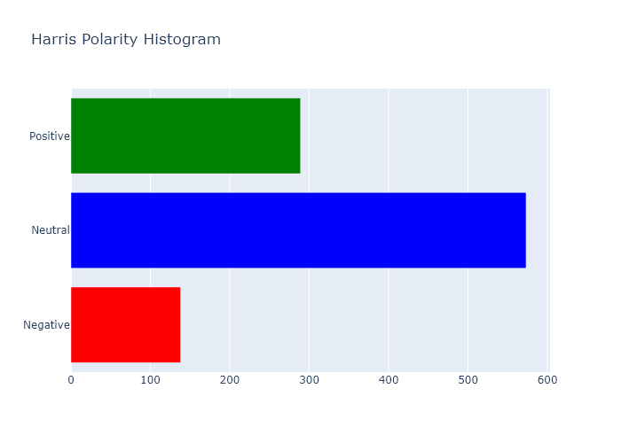
Histogram
Pence:
positive 291
negative 155
neutral 555
Harris:
positive 289
negative 138
neutral 573
Notes:
The positive percentage of Harris’ is larger than Pence’s

Slide 16
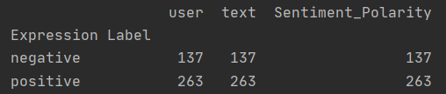
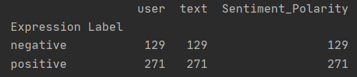
statistical results
Positive:
65.76%
Positive:
67.75%
Notes:
From detailed number, we can see that Harris have more positive replies than Pence.

Slide 17
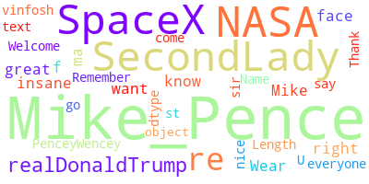
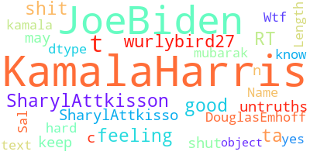
Word Cloud
Notes:
From those words ‘NASA’ and ‘Space X’, we can learn that people really concerned about the recent news that Pence promised that American astronauts will soon use American-made rockets to enter space.

Slide 18
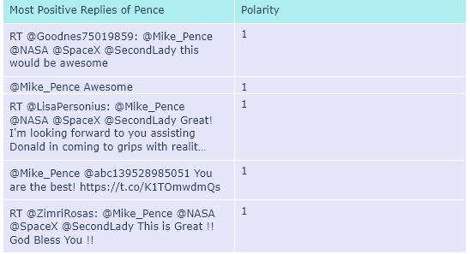
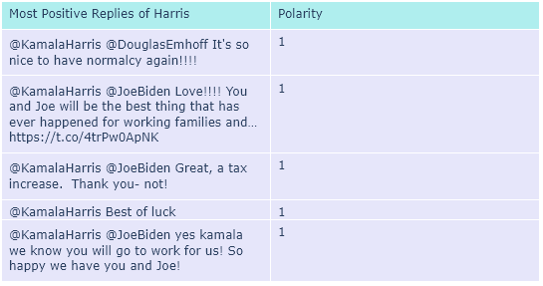
Most positive reviews
Notes:
Here are the most positive reviews in each person’s replies.

Slide 19
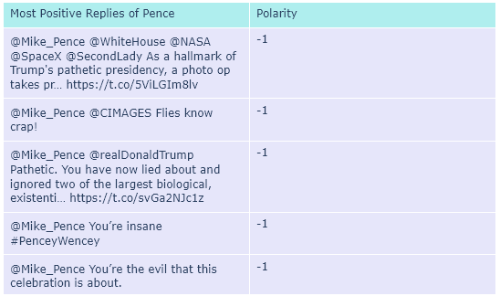
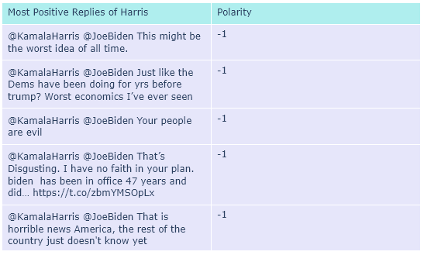
Most negative reviews
Notes:
Here are the most negative reviews in each person’s replies.

Slide 20
Data analysis
4

Slide 21
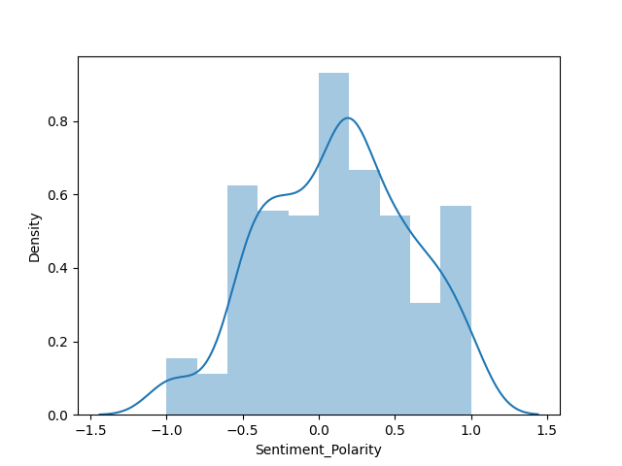
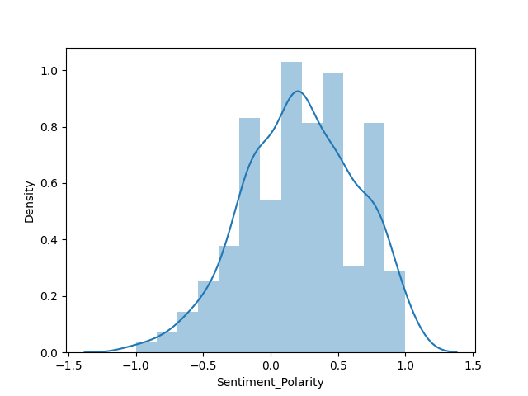
Distplot
Notes:
It is so clear that the difference of distribution of polarity between them is huge.
For Trump, most people are located in left side which is below 0. With the value of polarity become bigger, the density is going down.
Opposite to the Trump, Biden has less negative polarity. The density grows along with the value of polarity.

Slide 22
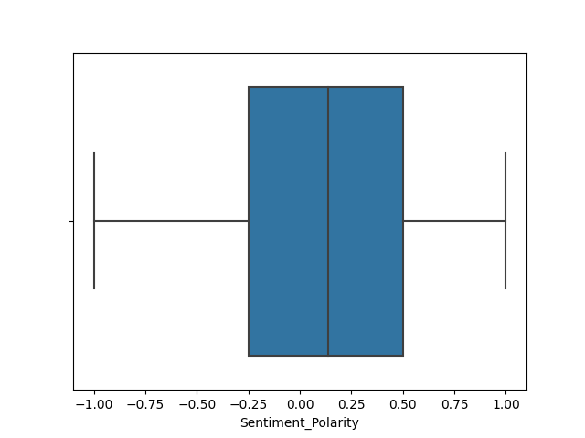
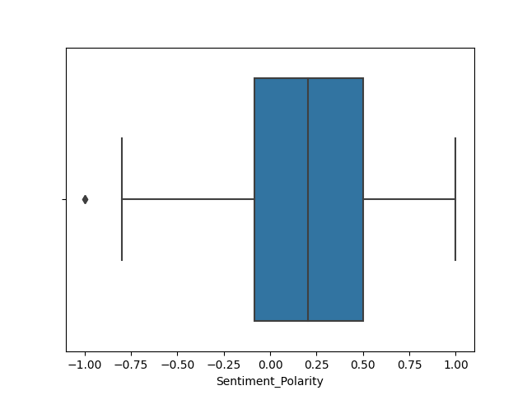
Boxplot
Notes:
From this boxplot we can learn that all of Biden's bottom edge, median, and two quartiles are greater than Trump’s.

Slide 23
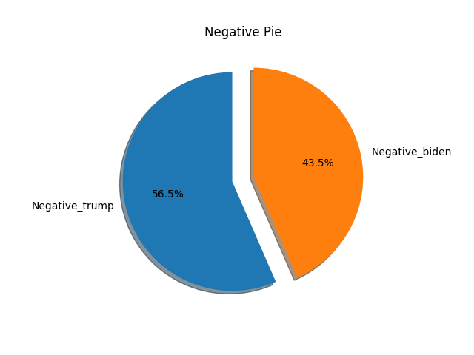
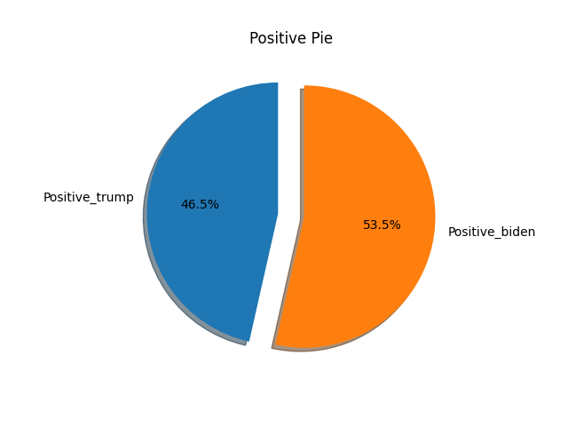
Negative pie chart
Positive pie chart
Notes:
It’s obviously that Trump wins the negative pie with 56.5%, and Biden wins the positive pie with 53.5%.

Slide 24
Vice President (optimal)

Slide 25
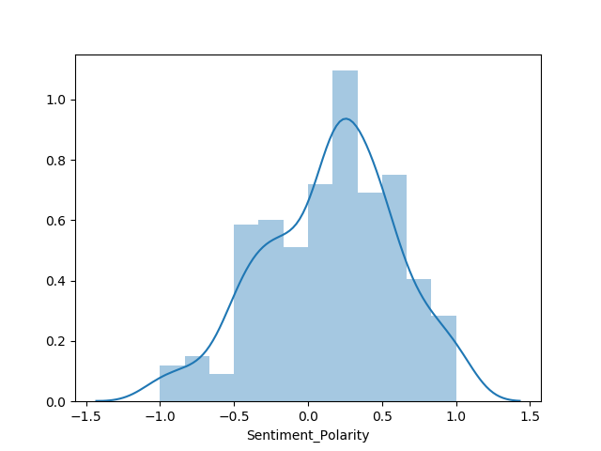
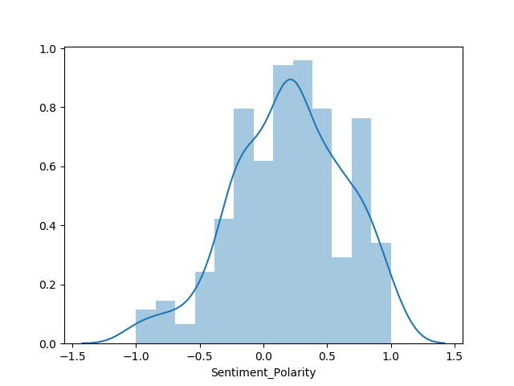
Distplot
Notes:
Different from the previous one is that the difference between these two people is very small.
But we still can get the information that Harris gets a better distribution.

Slide 26
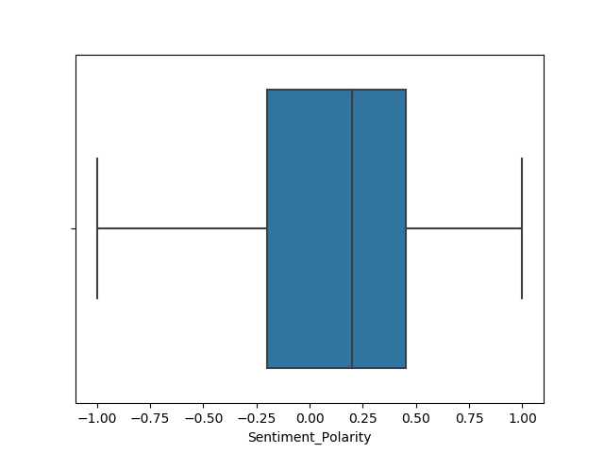
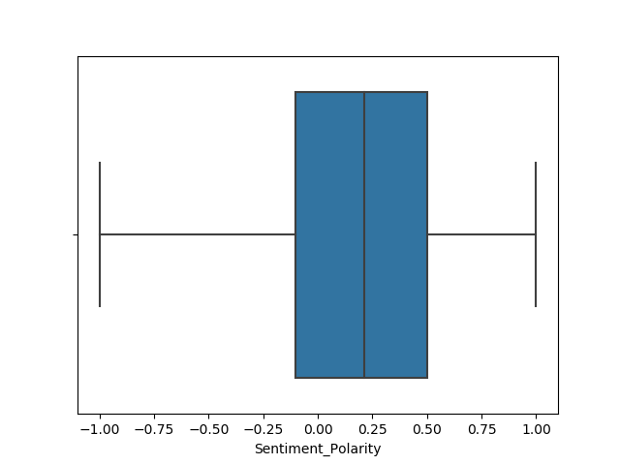
Boxplot
Notes:
Both median, and two quartiles of Pence is lower than Harris.

Slide 27
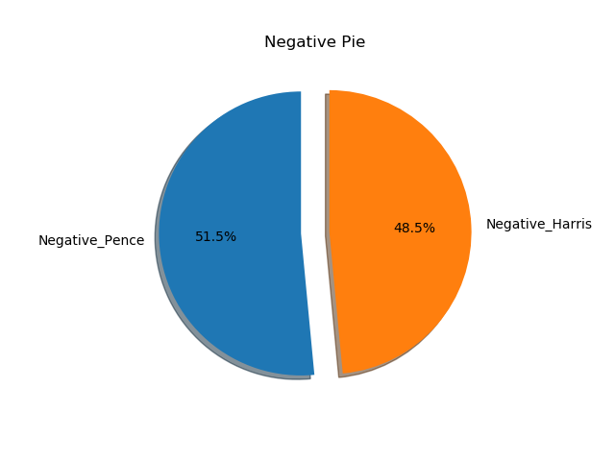
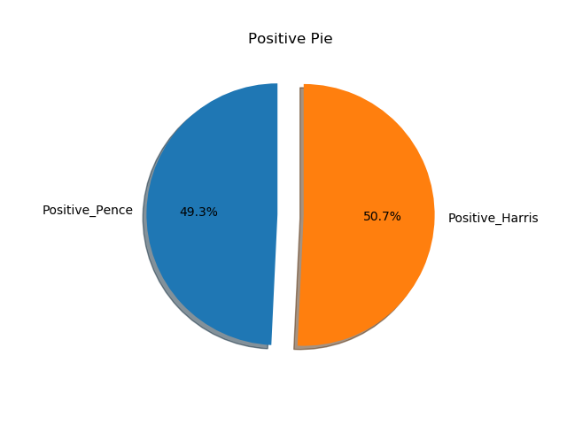
Negative pie chart
Positive pie chart
Notes:
We got very close results.
In the positive pie chart, they even differ by less than 1%
But still, Harris wins.

Slide 28
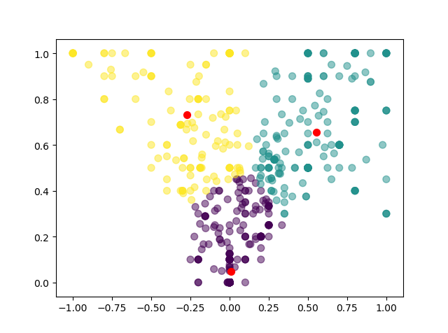
Clustering
The closer the reply polarity value is to 0, the more objective it is.
subjectivity
High polarity with high subjectivity
Low polarity with high subjectivity
Polarity around 0 with low subjectivity
polarity
Notes:
We clustered the replies with k-means to dig out more information from the data. We get the best solution when k = 3. So, comments can be divided into three clusters.

Slide 29
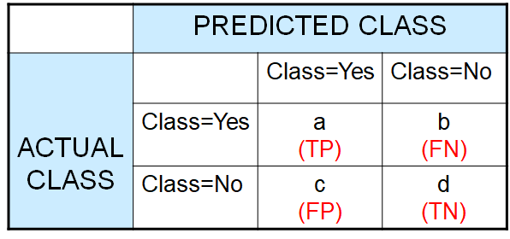
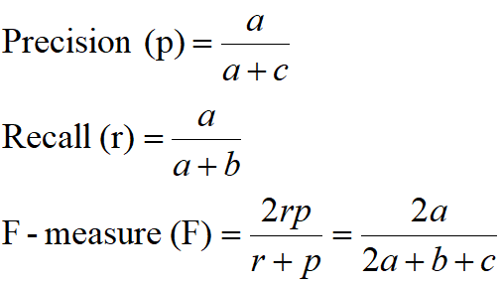
Evaluation
Notes:
We will evaluate our model based on F-score. We will calculate Precision and Recall. We will use this formula to compute F-measure to evaluate our model.

Slide 30
Future work
Improve in data cleaning
Evaluate the model
Scrape more data
Do more analysis between president and vice president.

Slide 31
Thanks!
Any questions?

